Slide 1
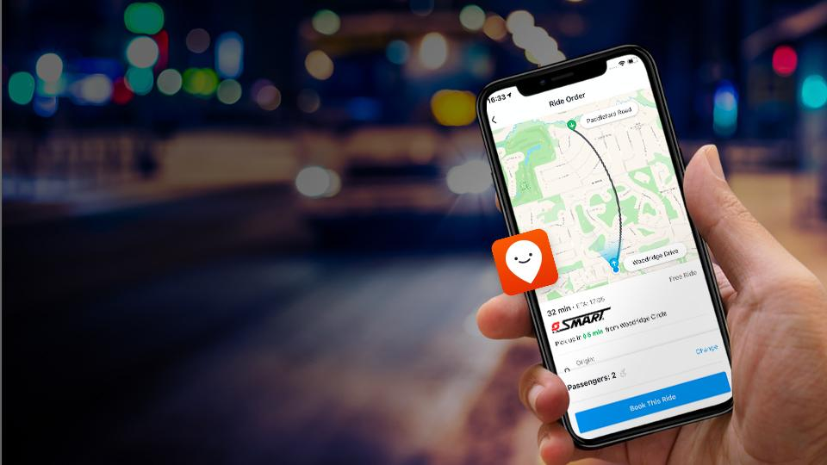
:משנים את חוויית הנסיעה
תחבורה על פי דרישה בישראל
אורן אללוף מנהל פעילות עסקית בישראל
Moovit, an Intel company, offers leading Mobility as a Service (MaaS) solutions and the world’s #1 urban mobility app
Notes:
Today, I’m going to discuss how cities and transport operators can better adapt to riders’ emerging mobility needs by implementing MaaS solutions that create a more rider-centric mobility network. By integrating the MaaS solutions that best work for your city and riders, you can turn the pandemic crisis into an opportunity to build back a more desirable and resilient transit system that works for everyone.

Slide 2
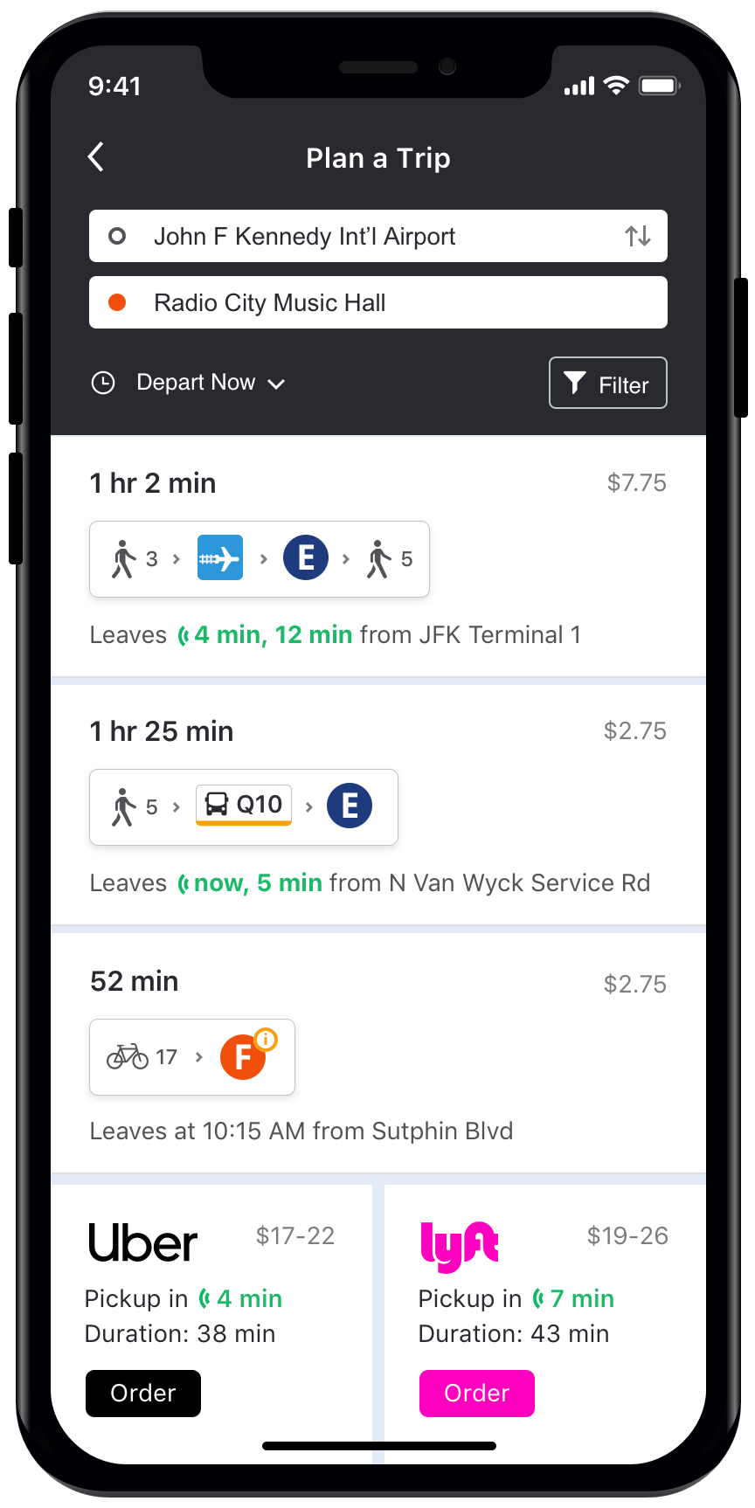
The Simplest and Most Intuitive Mobility App in the World
“
If you need to get anywhere by mass transit, you need Moovit.
It will open up a new world for you…
”
Notes:
Since 2012, Moovit has been updating its’ app, the Simplest and Most Intuitive Mobility Experience in the World.
Our mission is to simplify urban mobility, and in the app we do that is to let users compare and choose from all available multimodal services. That includes fixed routes, micromobility, ride-hailing and on-demand services, allowing riders to plan according to their time-cost tradeoff needs for a full picture of their journey before they leave their home.
Moovit’s advanced technology platform runs the world’s largest repository of transit & mobility data.
Why?
Because it combines all information about public transport and other mobility services including micro mobility, with real time & service alerts information and crowdsourced data, our secret sauce.
We take all of this together through our multimodal trip planner, to give users 1 app that has everything they need:
Trip Planner: the best way to get to my destination
With Real Time Arrival Times & Service Alerts
Payment Integration
And all mobility options (Public Transit, Taxis, Uber/Lyft, Scooters, Bikes, etc…)

Slide 3
users worldwide
1B+
112
3,400
7,500
countries
cities
transit agencies
45
320
languages
micro-mobility providers
Notes:
We’ve grown to have over 990M users around the world, that use our free app for Android, iPhone and the Web.
We offer services in 3400 cities across 112 countries. And our transit database has all the information of lines, schedules, stations of more than 7500 transit agencies and 320 micro mobility providers like bikes, scooters, car sharing services.

Slide 4
Moovit Urban Mobility Analytics
Insights about where, when and how people move around the city
People movement
Exportable Data
& Results Visualization
User attributes
Origin-Destination Matrices
Transit data
Transit Insights
Additional info

Slide 5
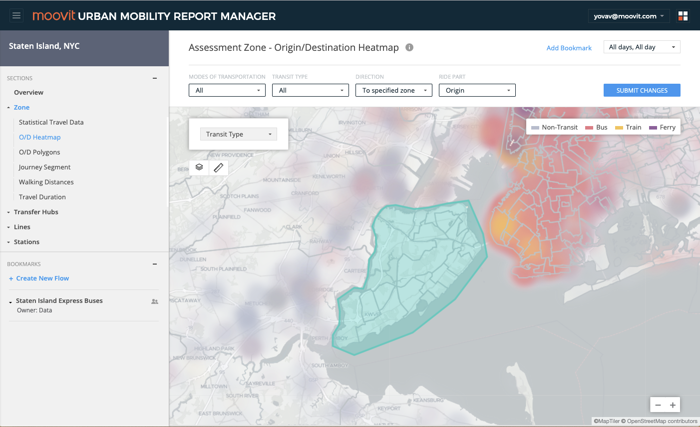
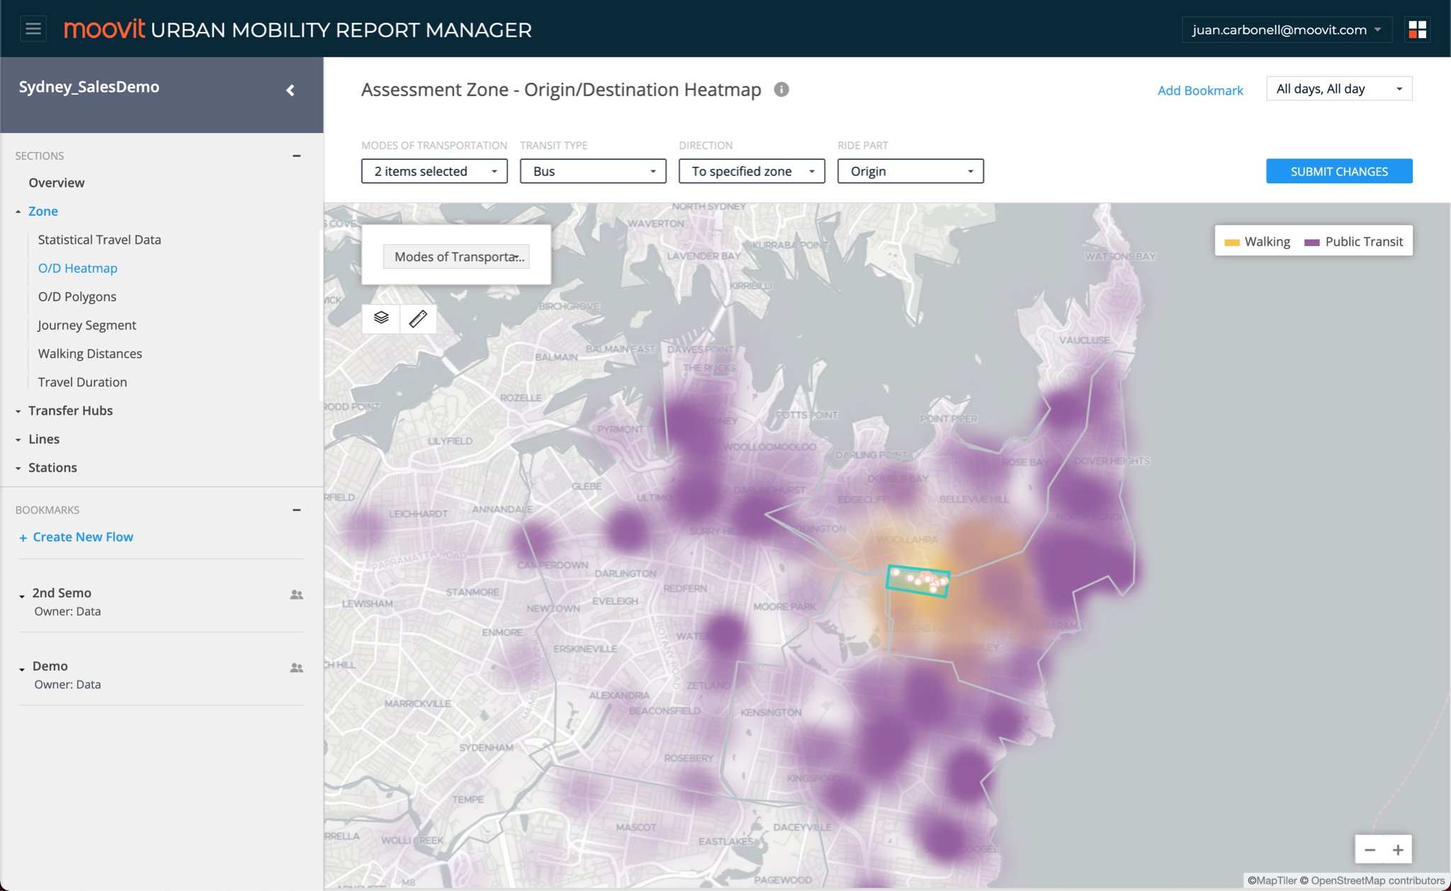
Visualising Your Network
1. Gap Analysis
Full analysis of a network segment to discover unmet needs, gaps and areas of opportunity
2. Corridor & LoS Analysis
Break service zones down into smaller, dynamic corridors for improved SLAs and higher efficiency
3. Simulation
Right-size operations by optimizing service areas and corridors, running times, fleet size, rider limits, and more
Notes:
Using Moovit’s Urban Mobility Analytics, we help you plan the right routes and corridors to make On-Demand routes more efficient. With our advanced data sources - most important of which are the real, anonymized passenger movements - we work with you to design a custom, sustainable on-demand solution from day one.
Moovit’s Urban Mobility Analytics data comes together to create a full picture of ridership patterns and behavior and transit service in your region, detecting areas lacking sufficient and/or efficient service - transit gaps and opportunities to solve your challenges with an on-demand solution.
Our analytics reports offer comprehensive insights and in-depth analysis on travel patterns, ridership on specific lines and from/to specific stations, and the critical nodes of specific high-volume zones.

Slide 6
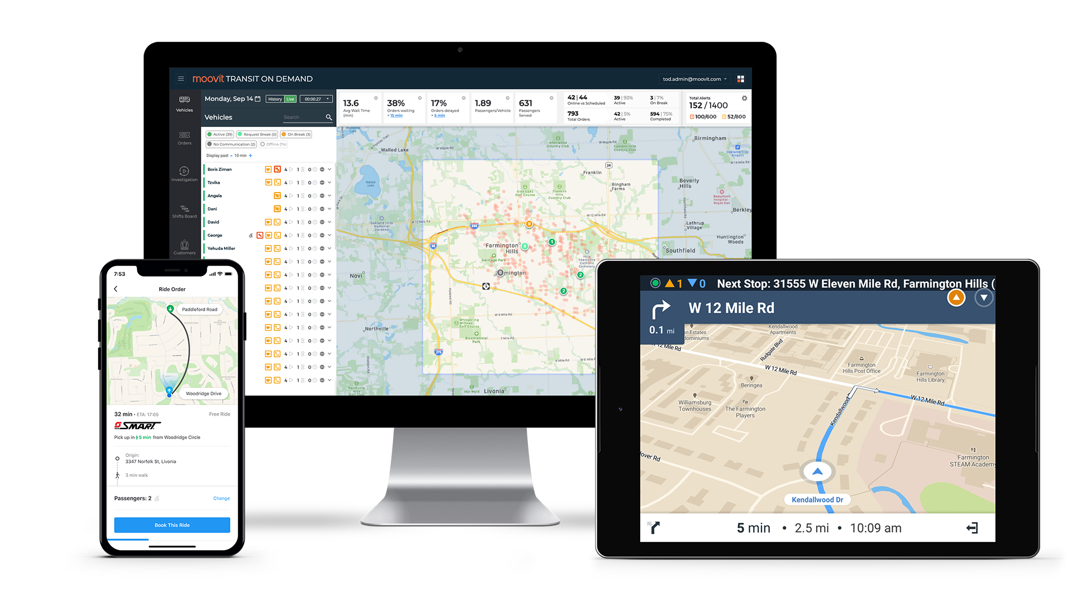
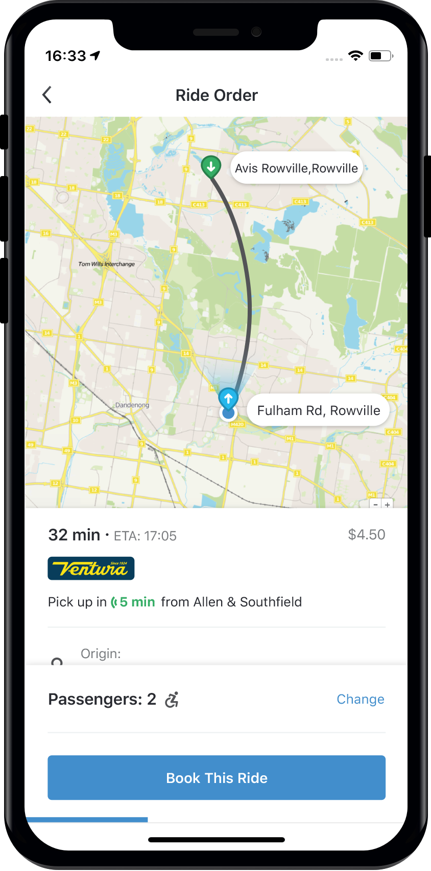
Powering Your On-Demand Service
Notes:
And for that, we created all the components an On-Demand operator needs: a Driver app, an app for the Riders and a Back office for the Operation center.

Slide 7
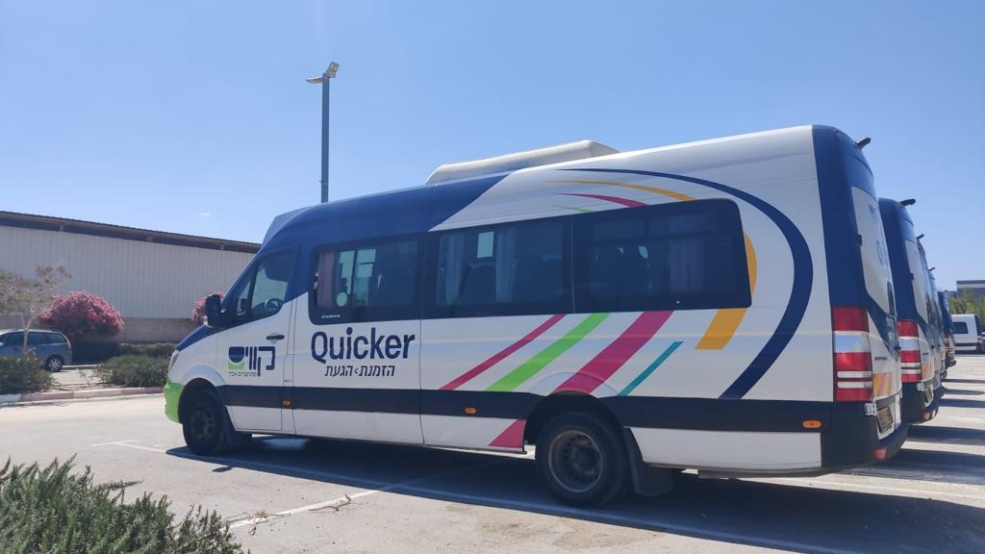
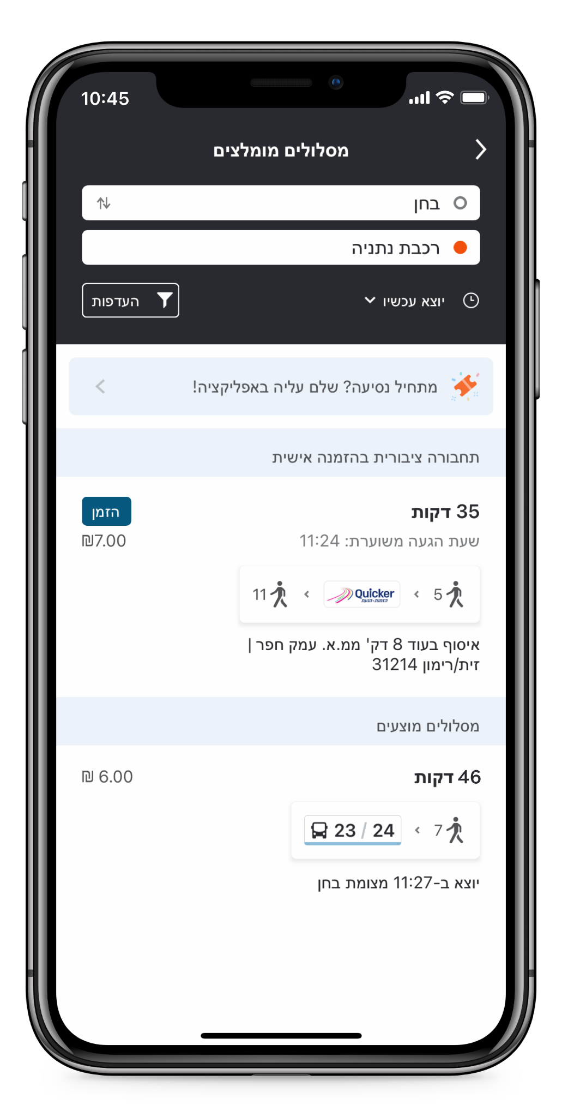
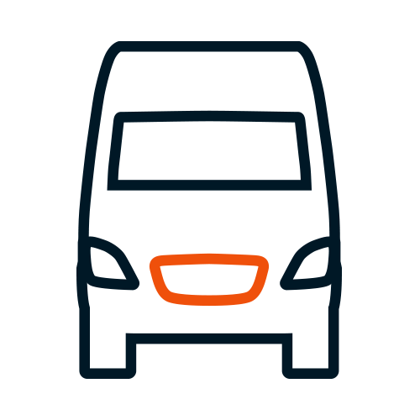
Case Study
קווים
עמק חפר ולב השרון, ישראל
Branded Apps
Payments & Ticketing
Urban Mobility Analytics
On-Demand
Real-Time for Buses
Carpool
Notes:
Ventura is Victoria, Australia’s largest public transport provider
42M+ annual riders
Popular Teleride service in Rowville, a Melbourne suburb, for over 30 years.

Slide 8
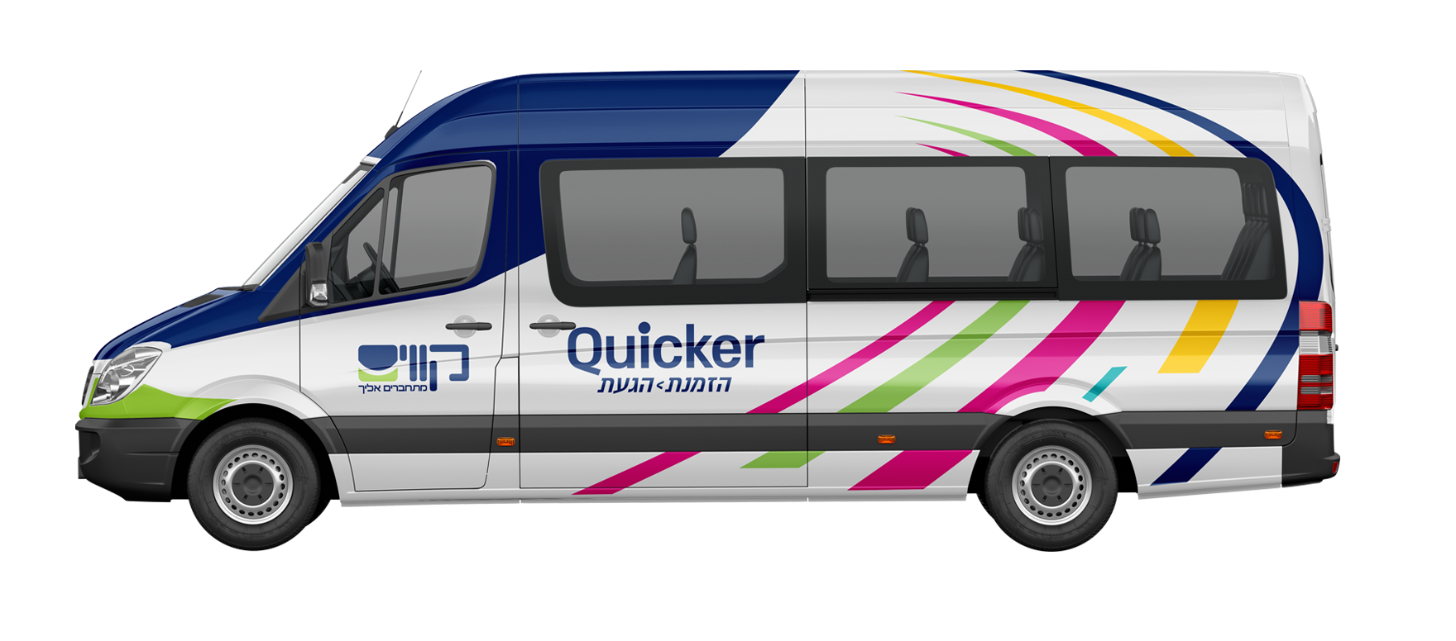
Case Study: Kavim
On-Demand
The Challenge
Why Moovit?
Infrequent bus service caused residents to depend on private cars
To create more attractive public transit options, Kavim and the Ministry of Transport wanted to replace the fixed-route bus routes with shared on-demand rides
To be successful, the service asks riders to pre-schedule during peak hours, and runs on-demand during off-peak hours
Complete multimodal MaaS app with on-demand service
Holistic ‘Plan, Ride, Pay’ MaaS experience
Depth & breadth of transit data and expertise in information management
Ability to plan and design a modern service to improve ridership and make getting around the region more efficient and convenient
"Smart shared transportation has made its way, for the first time, to the rural areas of the Sharon region. The project will allow the residents of the area to move around comfortably, quickly, and at an equal price per person, streamlining the public transport service in the area."
Miri Regev
Ministry of Transport and Road Safety, Israel
Notes:
Goals of new on-demand service:
Reduce wait time
Provide more frequent service
Increase patronage on Telebus services as well as local public transit
Ventura replaced three existing, underperforming bus routes going between Stud Park Shopping Centre and Ferntree Gully Station with new FlexiRide service
FlexiRide uses a Moovit white label app, branded with Ventura’s logo and brand colors for a unique look and feel, with the FlexiRide service powered by Moovit On-Demand.
With over 100 virtual stops located within the service area, FlexiRide passengers are always just a short distance from their pick-up point.
Passengers with accessibility requirements are able to request a more tailored door-to-door service Bookings on-demand and up to a week in advance
FlexiRide app allows users to plan all their public transport rides in Melbourne and surrounding areas, making the app a one-stop-shop for all Melbourne citizens’ urban mobility needs
https://docs.google.com/document/d/1q7LcIXeSx4wQnyE5lOsaXjrpPJsnXettpWTooBOSkd4/edit#

Slide 9
שירות תחבורה על פי דרישה של חברת קווים
Notes:
Let’s take a look at this short video of how the QuickConnect service works day-to-day

Slide 10
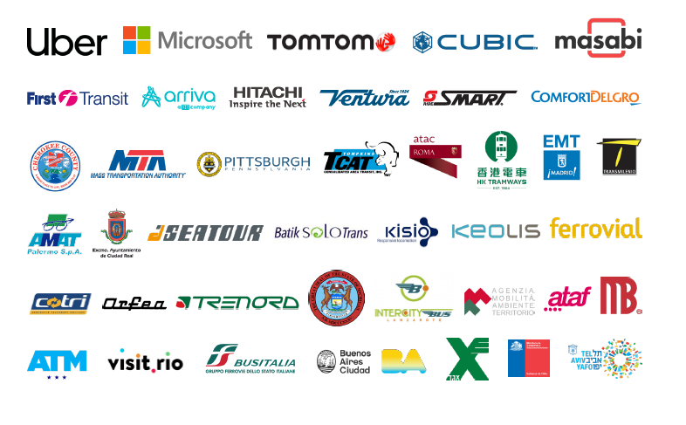
The Clear Choice for Global Leaders
Notes:
And for that, we created all the components an On-Demand operator needs: a Driver app, an app for the Riders and a Back office for the Operation center.

Slide 11
רוצים לראות איך הפתרון שלנו עובד?
moovit.me/demo-il

Slide 12
Case Study: קווים
On-Demand
The Challenge
Why Moovit?
Complete multimodal MaaS app with on-demand service
Depth & breadth of transit data and expertise in information management
Bring modernized service to the region to improve ridership and make i more efficient and convenient to get around
The pilot program is starting with 20 vehicles
Combines smart shuttles and on-demand
The service will also provides rides to Netanya central station, Ruppin college, and Hadera central station
Big rural region with low passenger counts on the buses
Bus comes infrequently, so a lot of people are driving and not using public transport
Notes:
Goals of new on-demand service:
Reduce wait time
Provide more frequent service
Increase patronage on Telebus services as well as local public transit
Ventura replaced three existing, underperforming bus routes going between Stud Park Shopping Centre and Ferntree Gully Station with new FlexiRide service
FlexiRide uses a Moovit white label app, branded with Ventura’s logo and brand colors for a unique look and feel, with the FlexiRide service powered by Moovit On-Demand.
With over 100 virtual stops located within the service area, FlexiRide passengers are always just a short distance from their pick-up point.
Passengers with accessibility requirements are able to request a more tailored door-to-door service Bookings on-demand and up to a week in advance
FlexiRide app allows users to plan all their public transport rides in Melbourne and surrounding areas, making the app a one-stop-shop for all Melbourne citizens’ urban mobility needs
https://docs.google.com/document/d/1q7LcIXeSx4wQnyE5lOsaXjrpPJsnXettpWTooBOSkd4/edit#

